Slide 2
四六级考前点播
闻 雯

Slide 3
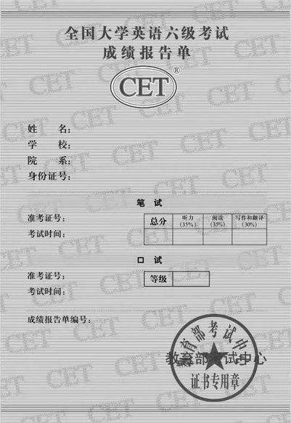
对标425~710*0.6
单项 | 单项总分 | 单项及格
听力（35%） | 248.5 | 150
听力（35%） | 248.5 | 150
翻译&写作（30%） | 213 | 127
总分 | 710 | 427

Slide 4
单项 |  | 测试内容 | 题数 | 分值 | 考试时间
听力(35) | 四级 | 短篇新闻 | 7 | 1分/题 | 25分钟
 |  | 长对话 | 8 | 1分/题
 |  | 听力篇章 | 10 | 2分/题
 | 六级 | 长对话 | 8 | 1分/题 | 30分钟
 |  | 听力篇章 | 7 | 1分/题
 |  | 讲话/报道/讲座 | 10 | 2分/题

Slide 5
单项 | 测试内容 | 题数 | 分值 | 考试时间
阅读(35) | 选词填空 | 10 | 0.5分/题 | 40分钟
 | 段落匹配 | 10 | 1分/题
 | 仔细阅读 | 10 | 2分/题
翻译(15) | 中译英 | 1 | 15分 | 30分钟

Slide 6
1、写作

Slide 7
写作注意事项
1、三段（缩进式）
2、字迹一定要端正，卷面整洁，涂改清晰
3、控制词数，检查语法/拼写错误

Slide 8
现在该做什么
1、准备好自己的模板（适用于不同主题）
2、用答题卡再写几遍真题（把模板写熟，看看够不够写）
3、有时间的同学可以适当背背优秀范文

Slide 11
Recently, ①… has hit the headline of newspapers, which has aroused wide public concern. As is vividly described in the ironic cartoon___________.
It is of no difficulty to come up with some possible dangers brought about by② ... .On one hand, ③…may exert negative effects on our country, which becomes the stumbling block in the harmonious relationship among people. Therefore, we should endeavor to stop the behavior. On the other hand, ④… poses threat to individuals’ lives, which widens the gap between people.
Taking all the above reasons into consideration, we may safely come to the conclusion that ⑤…is harmful. More media coverage and the enhancement of public awareness will make a positive change.

Slide 12
2、听力

Slide 13
注意事项
1. 耳机电池确保是全新的
2. 录音结束收答题卡
3. 利用读题时间： 大约有20s

Slide 14
现在该做什么
真题，听音频，跟读模仿
2. 注意比较原文和答案之间的关系

Slide 15
主要关系？（视听同向）
1、一模一样
2、单词词性变化
3、单词同义替换
4、实力听懂

Slide 16
# 一模一样/词性变化
…Almost all companies recognize the importance of innovation today, but not many are able to integrate innovation into their business…. many people tend to assume that innovation just means creating something new，but actually it’s more than that….The article …, saying a real innovative company should develop an innovation culture (2016.6)
5. D) Failure to integrate innovation into their business.
6. B) It is the creation of something new.
7. C) Its innovation culture.

Slide 17
# 同义替换
I‘d like to relive a period I’ve already lived – the 1960s. I was in my twenties, and everything was being renewed. （2017.6）
A) Everything seemed to be changing. B) People were formal and disciplined. C) People were excited to go travelling overseas. D) Things from the Victorian era came back alive.

Slide 18
…Today’s demographics show that the ①middle-class is disappearing and now the richest 1% of the population has amassed more wealth than the bottom 90%. …②Americans thought that if they worked hard enough, even in the phase of adversity, they would be rewarded with success. … And if you ask low-income people what’s the one thing that would change the life, ③they’ll say “a full-time job”. That’s all they aspire to.
…. Businesses, in order boost their profits, ④hire employees as part-time workers only. …(2018.12)
22. A) Its middle-class is disappearing.
23. B) They could realize their dreams through hard work.
24. D) Full employment.
25. C) Hire part-time employees only.

Slide 19
高频词~关键词~正确选项
Learning how different cultures signal respect can help you avoid misunderstandings…. In the deaf culture of North America, ….. In some cultures, both overseas and in some minority groups in North America, listeners are considered disrespectful if they look directly at the speaker. Respect is …
A. How listeners in different cultures show respect.

Slide 20
# 听懂
I remember my aunt Mary used to say if you swallow a cherry stone, a tree would grow out of your mouth.（2017.6）
Q: What did aunt Marry used to do when the man was a child?
A. Warn him of danger by making up a story. （√）
B. Give him some cherry stones to play with. （X）
C. Do something funny to amuse him.
D. Tell him to play in her backyard.

Slide 21
3、阅读理解

Slide 22
注意事项
1、先题后文
2、圈划题干关键词，一般顺序原则定位原文
3、排除法是个有效方法

Slide 23
① 题干 —— ② 定位 —— ③ 答案
55. What can we infer from the last paragraph?
A) Doctors and surgeons will soon be laid off.
B) The robotics industry will soon take off.
C) Robots will not make nurses redundant. D) Collaboration will not replace competition.

Slide 24
A) Doctors and surgeons will soon be laid off.
B) The robotics industry will soon take off.
C) Robots will not make nurses redundant. D) Collaboration will not replace competition.
It’s important to note that robotic nurses don’t decide courses of treatment or make diagnoses (though robot doctors and surgeons may not be far off). Instead, they perform routine and laborious tasks, freeing nurses up to attend to patients with immediate needs. This is one industry where it seems the integration of robots will lead to collaboration, not replacement.
Notes:
C

Slide 25
现在该做什么？
1、阅读三项做题顺序
2、刷真题
3、尽可能认识真题中不认识的单词

Slide 26
4、翻译

Slide 27
分数 | 具体要求
13~15 | 译文准确表达了原文的意思。用词贴切，行文流畅，基本上无语言错误，仅有个别小错。
10~12 | 译文基本上表达了原文的意思。文字通顺、连贯，无重大语言错误
7~9 | 译文勉强表达了原文的意思。用词欠准确，语言错误相当多，其中有些是严重语言错误。
4~6 | 译文仅表达了一小部分原文的意思。用词不准确，有相当多的严重语言错误。
1~3 | 译文支离破碎。除个别词语或句子，绝大部分文字没有表达原文意思。
0 | 未作答，或只有几个孤立的词，或译文与原文毫不相关

Slide 28
核心思想：
用正确的英文写出基本正确的中文意思

Slide 29
巧妇难为无米之炊
1、Even a clever woman cannot cook a meal without rice. 2、One can't make bricks without straw

Slide 30
现在该做什么
1、请认真刷题，注意积累单词，短语和句式
2、四六级翻译可以互相练习

